Slide 1
Entrepreneurship and Youth Empowerment
Young Political Leadership School
May 11, 2018; Monrovia
Wainright Y. Acquoi
Director of Communications, SMART Liberia. Co-founder, TRIBE. YALI Fellow ‘17

Slide 2
Learning Objectives:
Learn about entrepreneurship, entrepreneurs and the entrepreneurial process
Develop an entrepreneurial mind-set
Learn how to generate new ideas and identify business opportunities The concept of Social Entrepreneurship

Slide 3
THINKING OUT OF THE BOX: CONNECT THE DOT

Slide 4
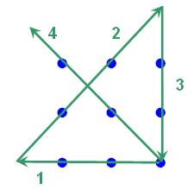
THINKING OUT OF THE BOX: CONNECT THE DOT

Slide 5
General Discussion: What do you see?

Slide 6
Note: People see things differently
Old Lady
Young Lady
Shows that your past experience may be
influencing how you see things
Perception is reality
Focus on the collective mean and then after
focus on the perception

Slide 7
THE ENTREPRENEURIAL IMPERATIVE IN LIBERIA: why is entrepreneurship critical in the Liberian context?
Youth comprise 65% of the population of some 4.5 million. The United Nation reports that 85% of Liberian youth are unemployed.
Underdeveloped economy
High level of unemployment
High level of extreme poverty
Low level of agricultural output
Low level of technological innovations
Low level of quality of life

Slide 8
The Entrepreneurial Attributes:
- Searching and taking advantage of opportunities
- The art of turning ideas into a business
- Entrepreneurship is a process
- It is an individual or a team effort
- Entails creativity, drive, and willingness to take risks

Slide 9
What is Entrepreneurship?
Entrepreneurship - is a process of identifying and starting a business venture, sourcing and organizing the required resources and taking both the risks and rewards associated with the venture.

Slide 10
Key Elements
Opportunity identification
Organizing resources
Taking risks

Slide 11
Who is an entrepreneur?
List Three Successful Entrepreneurs in your country.
Write three attributes/qualities of each entrepreneur that have in part accounted for his/her success

Slide 12
Who is an entrepreneur?
No single psychological model of entrepreneurship has been supported by research
But, behavioral scientists, venture capitalists, investors, and entrepreneurs agree that success of the venture will depend a great deal upon the talent and behavior of the lead entrepreneur and his or her team
Myths still exist about entrepreneurs and entrepreneurship

Slide 13
Who is an Entrepreneur?
Someone who exercises initiative by organizing a venture to take benefit of an opportunity and, as the decision maker, decides what, how, and how much of a good or service will be produced. An entrepreneur supplies risk capital as a risk taker, and monitors and controls the business activities.

Slide 14
The key attribute of an entrepreneur is…???

Slide 15
PASSION!

Slide 16
After having passion, an entrepreneur must begin with…?

Slide 17
NEED!

Slide 18
Critical Skills for Entrepreneurs
The Discovery Skills :
Associating
Questioning
Observing
Experimenting
Networking
They use these skills to Innovate and Grow their Businesses

Slide 19
The entrepreneurial process
Deciding to become an entrepreneur
Coming up with successful business ideas
Transforming an idea into an entrepreneurial
firm
Managing and growing the entrepreneurial
firm

Slide 20
The entrepreneurial process framework
Product or Service
Market
Opportunity Recognition
Pursuit of opportunity
People and organisation
Resources and capital

Slide 21
Different forms of Entrepreneurship
Traditional Entrepreneurship
Corporate Entrepreneurship
Social Entrepreneurship

Slide 22
What is Social Entrepreneurship?

Slide 23
Social Entrepreneurship
Social entrepreneurship is the use of start up companies and other entrepreneurs to develop, fund and implement solutions to social, cultural, or environmental issues. This concept may be applied to a variety of organizations with different sizes, aims, and beliefs.

Slide 24
Social Entrepreneur
A social entrepreneur is a person who pursues novel applications that have the potential to solve community-based problems. These individuals are willing to take on the risk and effort to create positive changes in society through their initiatives.

Slide 25
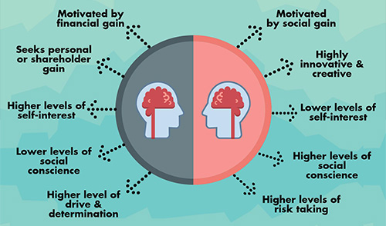
Traditional Vs. Social

Slide 26
Entrepreneurship and Youth Empowerment
Let’s have a conversation...

Slide 27
To provide meaningful education for the youths, which could make them self-reliant and subsequently encourage them to derive profit and be self dependent.
2. To provide small and medium sized companies with the opportunities to receive qualified graduates who will receive training and tutoring in the skills relevant to the management of the small business centers.
3. To provide youth with the training and support necessary to help them establish a career in small and medium sized businesses.
4. To provide youth with training in skills that will make them meet the manpower needs of the society
5. To provide youth with enough training that will make them creative and innovative in identifying new business opportunities.
6. To provide youth with enough training in risk management to make uncertainty almost possible and easy
Notes:
Youth Empowerment through Entrepreneurial... (PDF Download Available). Available from: https://www.researchgate.net/publication/272710343_Youth_Empowerment_through_Entrepreneurial_Development_in_Nigeria [accessed May 11 2018].

